Slide 1
A Literature Review on Sarcasm on Twitter Data Analysis
G.SRAVANI-180030171
V.SOWMYA-180030825
GUIDE-N.RAVINDER
BATCH NUMBER-579

Slide 2
ABSTRACT
The widespread and different types of information on Twitter make it one of the most appropriate virtual environments for information monitoring and tracking. In this paper, the we review the different information analysis techniques; starting with the analysis of different hashtags, twitter’s network-topology, event spread over the network, identification of influence, and finally analysis of sentiment. Future research and development work will be addressed

Slide 3
KEY WORDS
Big data, data analysis, social media, Twitter.

Slide 4
LITERATURE TABLE
TITLE | AUTHOR | METHEDOLOGY
Sarcasm detection and observing user behavioral | Sarika | Feature extraction Sentiment related features Syntactic and semantic features
Sentiment Analysis of Twitter Data | Apoorv Agarwal | -Feature analysis
A literature review of twitter data analysis | Akram salah | -Machine learning approach -NLP

Slide 5
Literature table
TITLE | AUTHOR | METHODOLOGY
Machine learning based sentiment analysis for twitter accounts | Ali Hasan | Machine learning
Pattern based approach for sarcasm detection on twitter | Mondher | -Classification -Semantic features analysis

Slide 6
INTRODUCTION
The growing phenomena of social media, such as: Facebook, Twitter, Linkedin, and Instgram, with each one has its own characteristics and its usages, are constantly affecting out societies. Facebook, for example, is considered as a social network where everyone in the network has a reciprocated relationship with another one in the same network. The relationship in this case is undirected. Conversely, in Twitter everyone in the network does not necessarily have a reciprocated relationship with others. In this case, the relationship is either directed or undirected.

Slide 7
In this paper, we focus on twitter for data analysis, where twitter is an online networking service that enables users to send and read short 140- character messages called “tweets” [1]. In addition to its publicity, twitter is accessible for unregistered users to read and monitor most tweets, unlike Facebook where users can control the privacy of their profiles. Twitter is also a large social networking microblogging site. The massive information provided by twitter such as tweet messages, user profile information, and the number of followers/ followings in the network play a significant role in data analysis, which in return make most studies investigate and examine various analysis techniques to grasp the recent used technologies.

Slide 8
Literature Review Methods
To track and monitor different datasets, most studies began with collecting the desired datasets from twitter, and applied filtering techniques to remove redundant data or spam tweets.
TYPES
Datasets
Data Retrieval Ranking and Classifying Twitter Users
Homophily
Reciprocity

Slide 9
Information Diffusion
Since there are different kinds of information spread over twitter, there is no agreement on what kind of information is more widely spread than others. There is also no agreement on how messages are spread over twitter network.

Slide 10
TYPES
Event Life Cycle
Regarding the difficulty of tracking a specific event for a long period of time, [9] followed an effective technique by tracking a specific hashtag on different times and employed a comparison between them to examine the fluctuation of the event life cycle as they investigated three metrics to track each hashtag.

Slide 11
Network-Topology Analysis
Networks consist of levels of a hierarchal fashion, that is a first-network topology, a second-network topology of the first-network topology, and so on. Most studies have focused on the first-network topology for analyzing information diffusion over twitter for instance, studied the first-network topology to examine information spread.
Retweetability
Retweet in twitter is the agreement action to a specific tweet, as in some cases the user passes information to his/her audiences to express their opinion on a particular tweet. The mechanism of retweetability plays a prominent role in information diffusion.

Slide 12
Influence on Twitter
Social influence occurs when an individual’s thoughts or actions are affected by other people .Examining the influential users is related by the message propagation by answering on the following questions; who are the originators of the tweets, how many audiences they have, and what is the retweet rate of the original tweet.

Slide 13
ALGORITHMS USED
Sentiment analysis is the measure of people’s opinions on the level of agreement on a specific topic, a product, or a service, or even elections. Two approaches had been employed to study the sentiment analysis: natural language processing, and machine learning algorithms.
Natural Language Processing Approach
According to , natural language processing (NLP) is the interaction between computers and human (natural) languages. To evaluate sentiment of users online, particularly on twitter, effective sentiment annotation should be used. Most studies use the three common sentiment labels: positive, neutral, and negative.

Slide 14
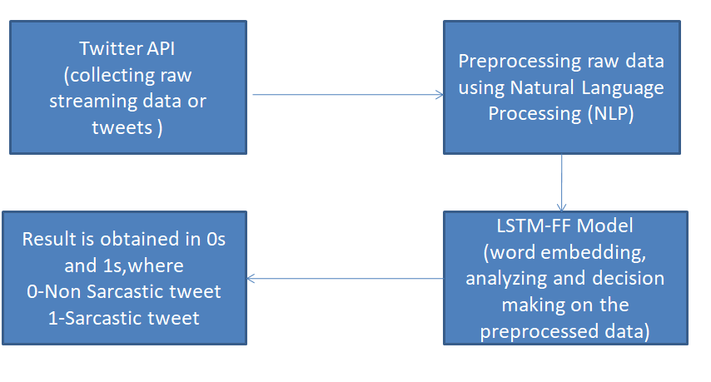
System Architecture

Slide 15
Machine Learning Approach
According to , machine learning (ML) is a scientific discipline that explores the construction and the study of algorithms that can learn from data. used the machine learning approach in analyzing the sentiment of twitter users. Applied a rule-based, supervised, and semi-supervised techniques, and collected tweets about the president (Obama) to measure the sentiment of people’s opinion towards his job performance. Furthermore, a cross-correlation analysis of time series was investigated to predict sentiments by labeling 2500 tweets to predict the test dataset of 550,000 unlabeled tweets.

Slide 16
CONCLUSION
The sheer amount and the different types of data on twitter and the public nature of tweets have allowed exploiting twitter information in data analysis. First, by measuring the life cycle of a specific topic by measuring the number of tweets over a period of time, and second by measuring the sentiment of users towards a specific topic through NLP and ML algorithms.

